Slide 1
ESD Protection Devices
By: Krish Patel
Under: Prof. Sandip Lashkare

Slide 2
Table of contents
01
02
03
04
What are ESD Protection Devices?
Modes of Operation
Electrical Characteristics of ESD Diode
Layout Consideration for ESD Diode

Slide 3
05
The NIPIN ESD Protection Diode

Slide 4
01
ESD Protection Devices

Slide 5
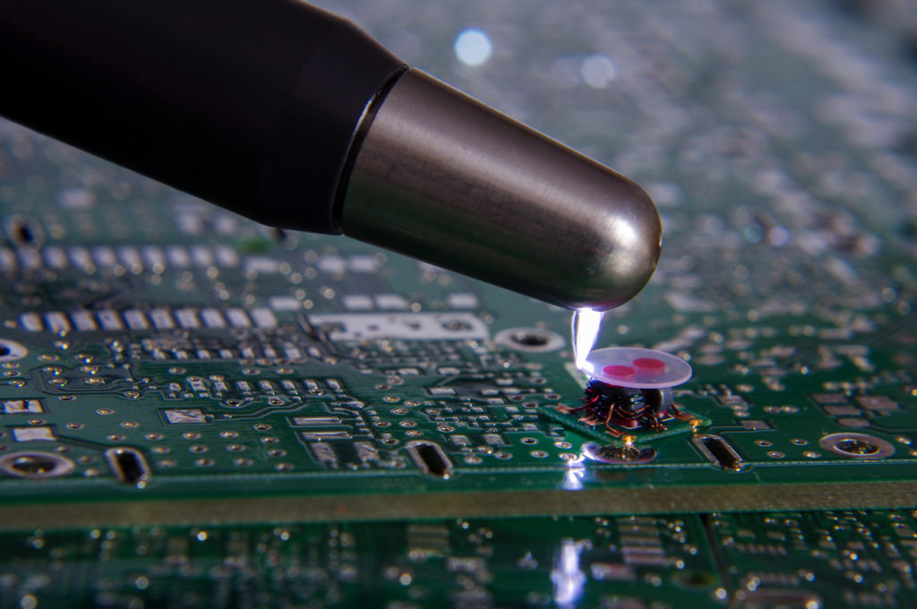
What is ESD?
Electrostatic discharge (ESD) is the sudden transfer of electric charge between two objects with different electrical charges. It can occur when two substances with opposite charges come into contact or get close to each other.
This event can permanently damage the IC of Electronic devices.

Slide 6
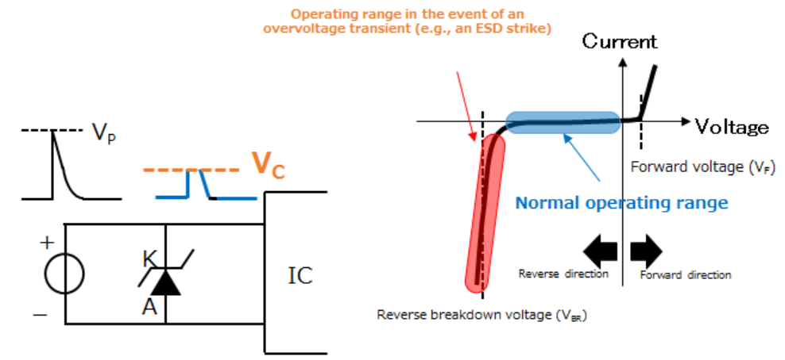
Protection diodes
A protection diode is a type of Zener diode specifically designed to protect electronic circuits from ESD and other transient pulses.
Protection diodes are used as voltage clampers for surge protection.

Slide 7
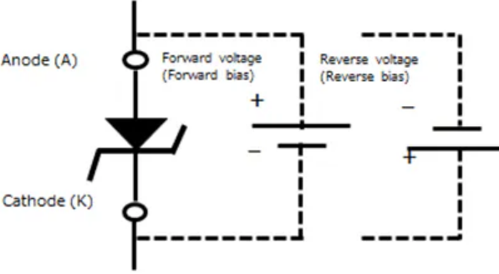
ESD Protection Device
There are two types of breakdown in semiconductor diode when diode is connected in reverse bias:
Zener Breakdown
Avalanche Breakdown
ESD Protection Devices are type of zener diode. Which passes high amount of current in reverse bias when diode reaches a certain breakdown voltage.
P
N

Slide 8
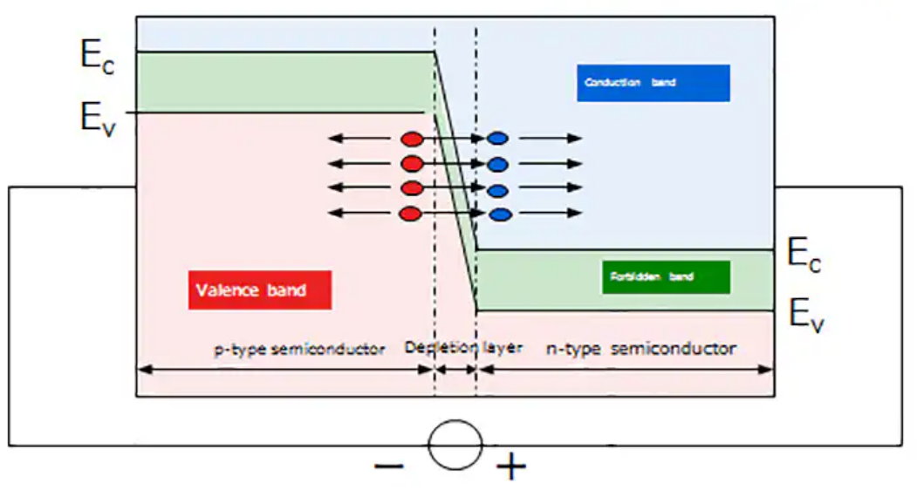
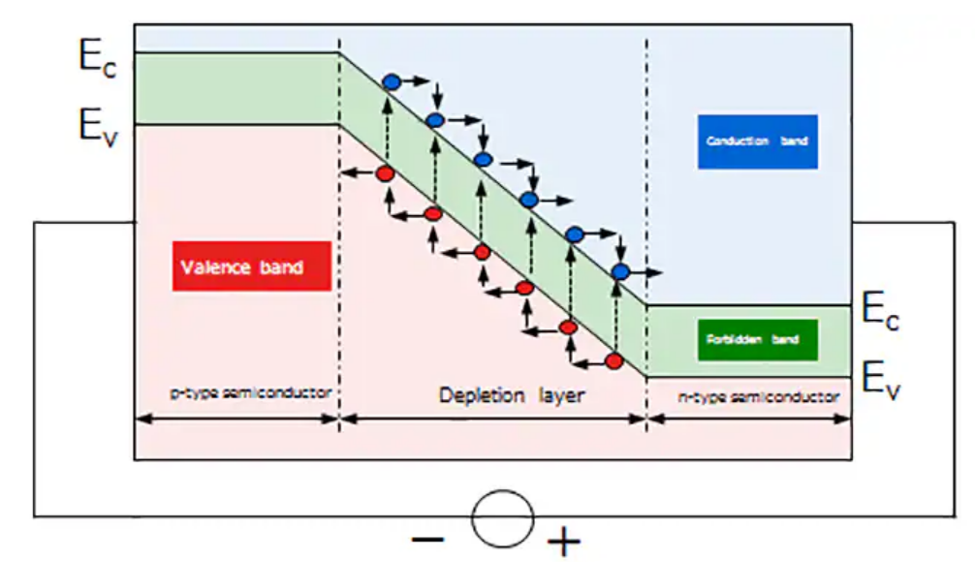
Zener and Avalanche Breakdown
When diode is under reverse bias a depletion region is formed across P-N junction.
In case of Zener diode the electric field lowers the energy gap between the p-type valence band and n-type conduction band. Electrons tunnel from the valence band (p-type) to the conduction band (n-type).
In case of Avalanche diode electrons gain kinetic energy in the depletion layer due to the electric field. High-energy electrons collide with crystal lattice atoms, creating electron-hole pairs which further ionize atoms, generating more electron-hole pairs.
Zener diode: Thin depletion region, heavily doped, low breakdown voltage
Avalanche diode: Wide depletion region, lightly doped, high breakdown voltage

Slide 9
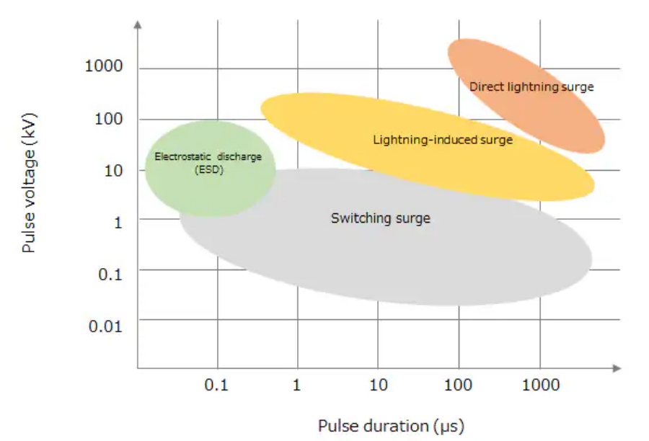
Types of voltage surge
There are broadly three types of surge events:
Electrostatic discharge (ESD): Sudden flow of electricity between two electrically charged.
Lightning-induced surge: Induced to the
inductance of long wires such as power supply
lines because of the effect of electromagnetic
pulses emitted by lightning strikes.
Switching Surge: An overvoltage transient
induced during the on/off switching of a
switch or a relay because of a sharp change in
current, circuit inductance.

Slide 10
02
Modes of Operations

Slide 11
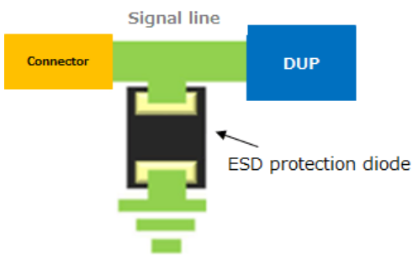
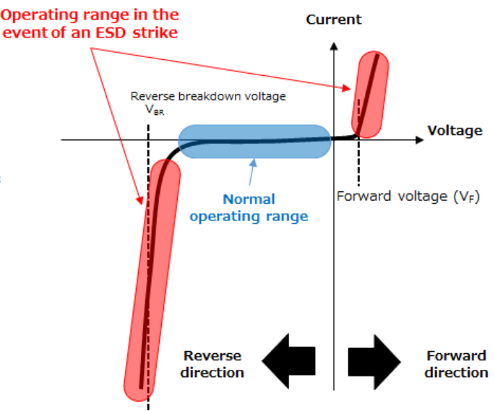
Equivalent Circuit of ESD Diode
ESD protection diodes are placed between signal lines and GND in order to protect a device under protection (DUP) from voltage surge.
In the normal operating mode, little current flows through the ESD protection diodes.
When a voltage surge higher than the reverse breakdown voltage (V_{BR}) is introduced into a signal line, the ESD protection diodes shunt excessive current to GND

Slide 12
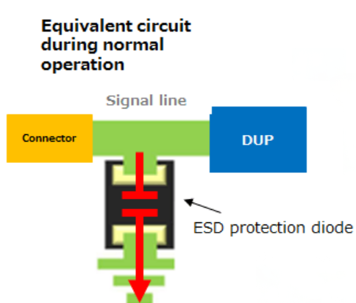
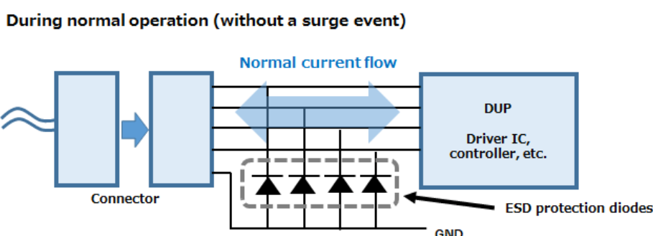
Normal Operation
In normal operating mode without surge event diode acts as a capacitor.
The resistance of signal lines and this capacitance act as a Low pass filter causing insertion loss(I_{L}).

Slide 13
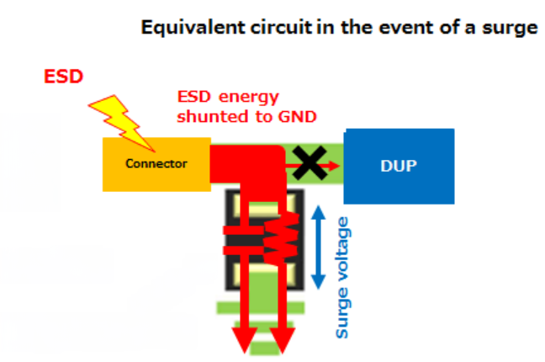
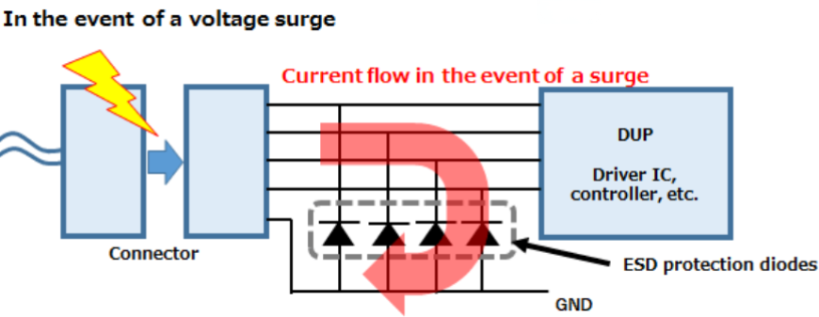
Event of ESD Strike
In an event of ESD strike much of the surge current is shunted to GND through them.
The dynamic resistance (R_{dyn}) of an ESD protection diode represents the ease of shunting surge current to GND.
ESD protection diodes with lower dynamic resistance allow less surge current to flow to the device under protection (DUP).

Slide 14
03
Electrical Characteristics of ESD Diode

Slide 15
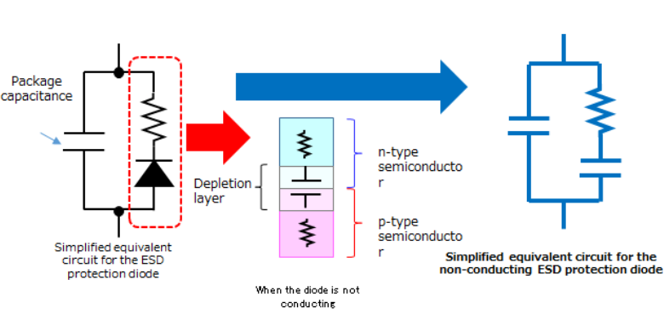
Normal Mode of Operation
During normal operation, the ESD protection diode does not conduct and acts as a capacitor due to the depletion layer across its PN junction. Key considerations for selection include:
Ensure Breakdown voltage(V_{BR}) is higher than the signal line's maximum voltage.
Verify the total capacitance (C_{T}) of an ESD protection diode is low enough with respect to the signal line's frequency.
Signal polarity.

Slide 16
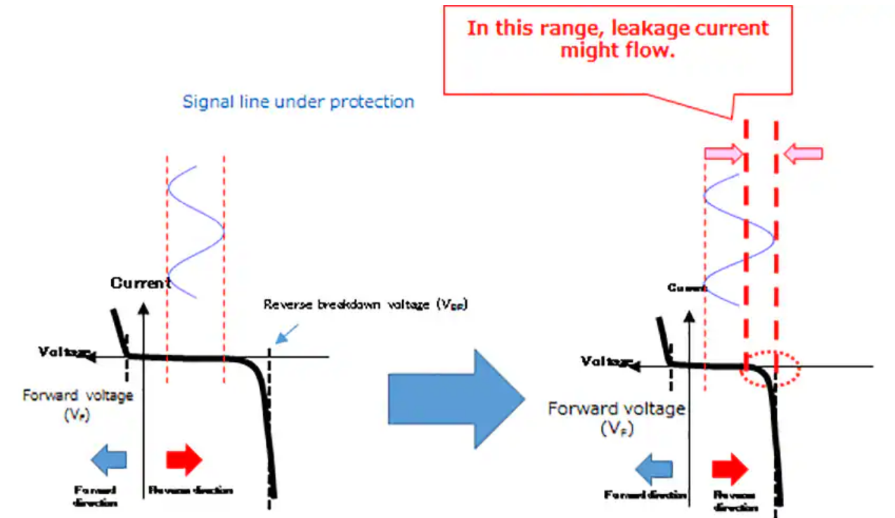
Breakdown Voltage(V_{BR}) of ESD Diode
As ESD diode approaches V_{BR} leakage current increases.
This leakage current might distort the signal as it increases exponentially with voltage.
The V_{BR} of the diode should be much higher than the amplitude of the signal in order to avoid this distortion.

Slide 17
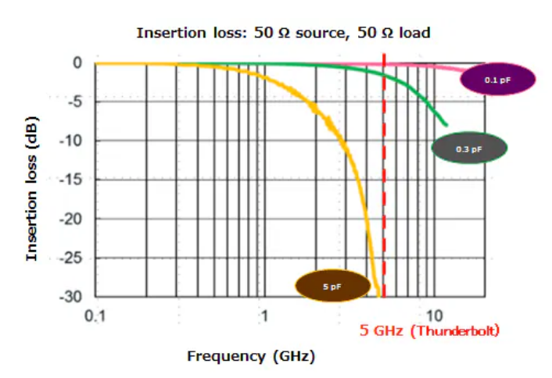
Capacitance (C_{T}) of an ESD Diode
Diodes when inserted in the signal lines causes insertion loss.
Due to which signal quality is degraded unless appropriate ESD protection diodes are selected, considering the frequency of the signal lines to be protected.
According to the graph, diodes with a larger capacitance cause higher insertion loss, restricting the frequency range in which they can be used.

Slide 18
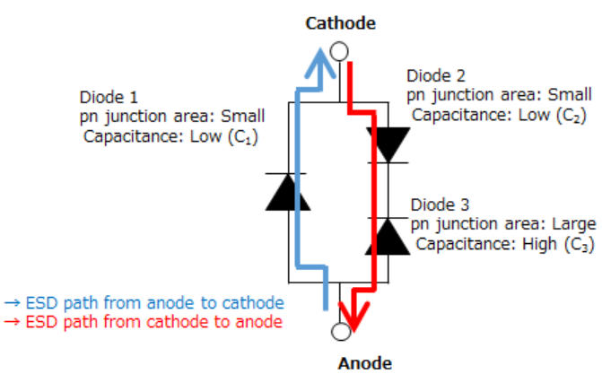
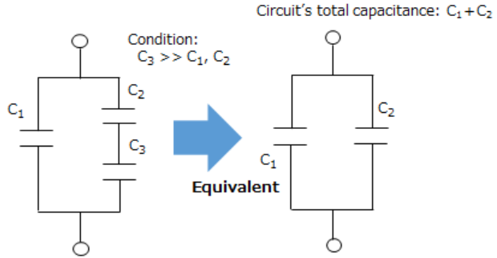
Low-capacitance Diodes 1 and 2 handle forward ESD currents, while high-capacitance Diode 3 handles reverse ESD currents, avoiding reverse stress on Diodes 1 and 2 for improved ESD immunity.
Connecting low-capacitance Diode 2 and high-capacitance Diode 3 in series reduces overall capacitance, minimizing signal degradation.
The circuit's breakdown voltage is determined by Diode 3, allowing customization to enhance ESD immunity for specific signal lines.

Slide 19
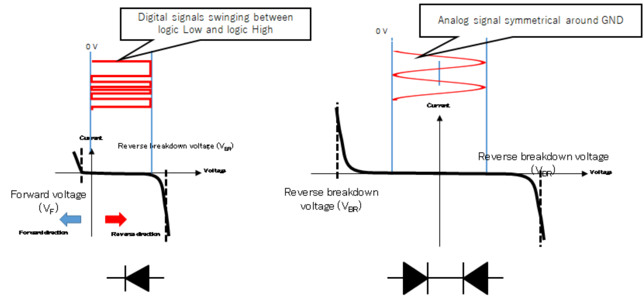
Signal Polarity
Unidirectional diodes are used for signals that swing only in one direction (e.g., 0 to 5 V).
Bidirectional diodes are used for analog signals with both positive and negative voltage swings.
Both diode types can protect signals with exclusively positive or negative voltages.

Slide 20
Diode under ESD Strike
When an ESD is introduced into a system, ESD protection diodes either conduct or enter reverse breakdown. Key considerations to protect DUP:
Low dynamic resistance (R_{DYN}).
Low clamp voltage (V_{C}) and first peak voltage.
Operations of an ESD protection diode to absorb ESD pulses with different polarities.

Slide 21
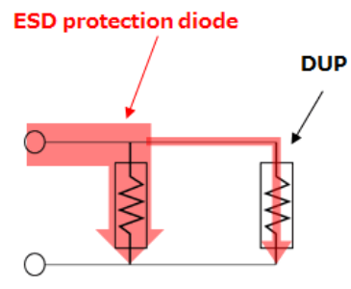
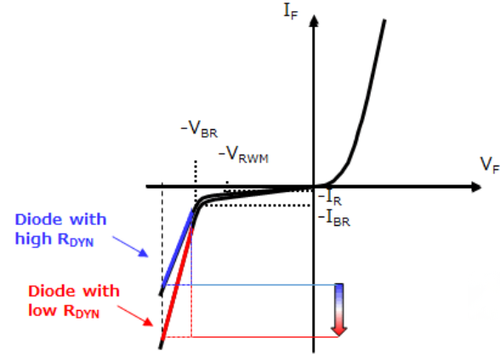
Dynamic resistance (R_{DYN}) of ESD Diode
The dynamic resistance of the diode is the ratio of the change in the voltage across the diode to the change in current through it.
It is represented by the formula: R_{DYN} = Δ𝑉/Δ𝐼.
R_{DYN} is the slope of the V_{F}–I_{F} curve in reverse conduction mode. In the event of an ESD strike, ESD protection diodes with lower dynamic resistance conduct more current at a given voltage.

Slide 22
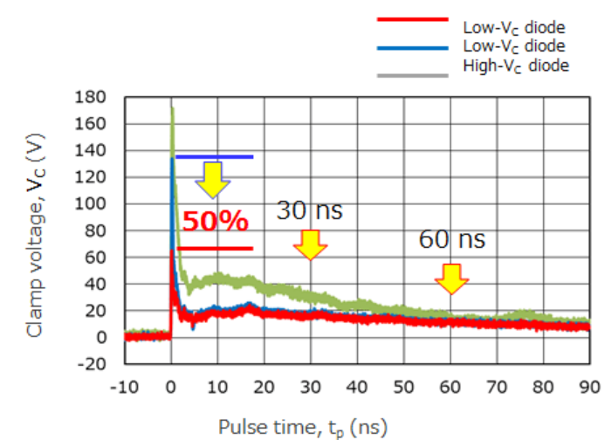
Clamp voltage (V_{C}) of ESD Diode
ESD protection diodes with lower VC reduce the area under the ESD waveform, minimizing damage to the device under protection (DUP).
The ESD protection diode with a lower V_{C} exhibits lower clamp voltage at 30 ns and 60 ns than the one with a higher V_{C}.
Some ESD diodes have delayed response times, allowing the first ESD pulse peak (exceeding VC) to reach the DUP, potentially causing malfunction or damage.

Slide 23
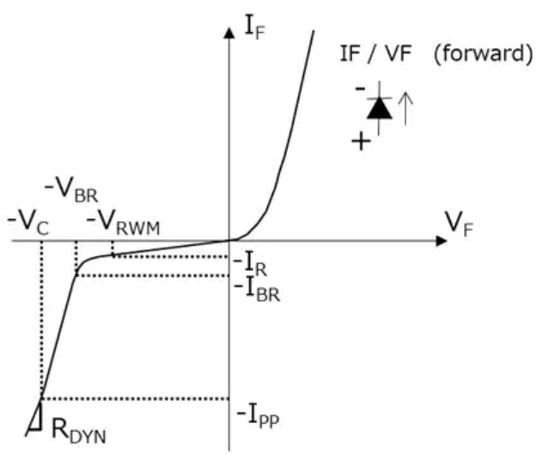
Electrical Characteristics
Working Peak Reverse Voltage (V_{RWM}): The maximum reverse voltage at which the diode exhibits high impedance with minimal leakage current.
Total Capacitance (C_{t}): The sum of junction and package parasitic capacitances at a specified reverse voltage and frequency.
Dynamic Resistance (R_{DYN}): The slope of the V_{F}–I_{F} curve between V_{BR} and V_{C}, indicating the diode's resistance during reverse breakdown.
Reverse Breakdown Voltage (V_{BR}): The reverse voltage at which the diode begins to conduct a specified current (typically 1 mA).

Slide 24
Reverse Current (I_{R}): The leakage current flowing in reverse direction at V_{RWM}.
Clamp Voltage (V_{C}): The maximum voltage to which the diode clamps during a peak pulse current.

Slide 25
04
Layout Considerations for ESD Diode

Slide 26
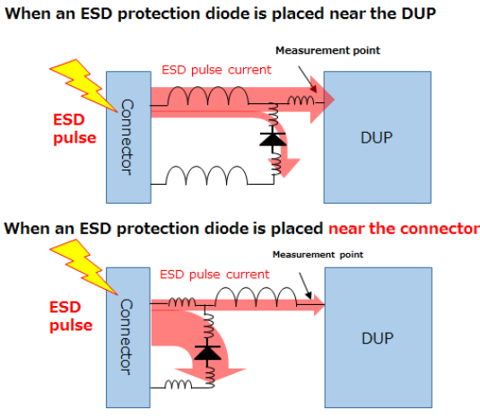
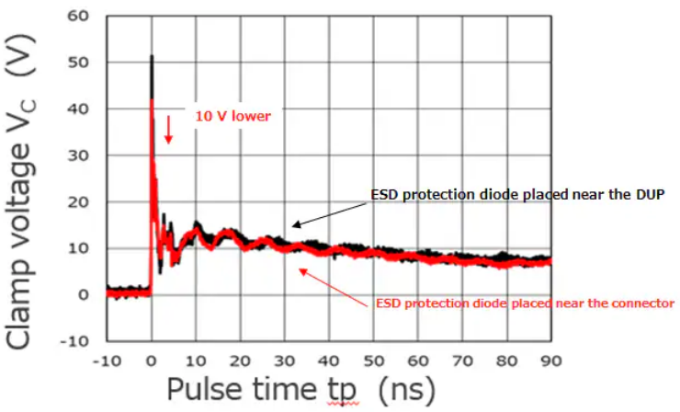
Placement of the ESD diode is done near the DUP.
This result in the reduction of inductance in series with the diode which reduces the clamp voltage of the diode as shown in the graph above.

Slide 27
05
The NIPIN ESD Protection Diode

Slide 28
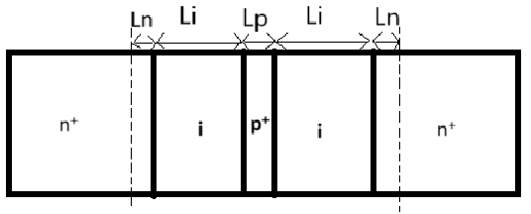
Electrostatics of NIPIN Diode
The NIPIN diode is a triangular barrier designed Silicon (n+-i-p+-i-n+) punch-through diode with variable voltage <0.5V to 2V for low voltage applications.
The n+ regions form emitter and collector of an open base BJT. The base region is formed of p+ region sandwiched between two intrinsic region. This structure can be modelled as a simple two capacitor in series model.

Slide 29
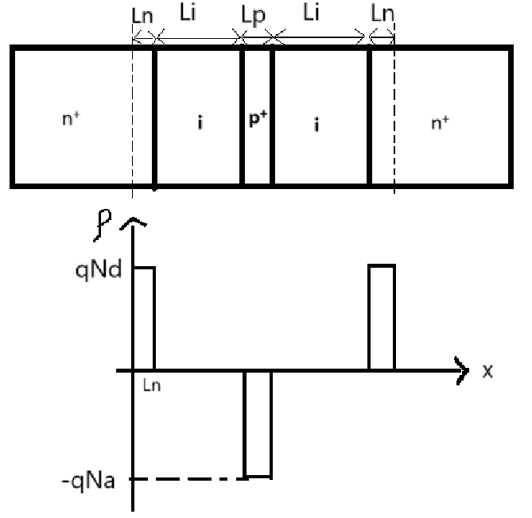
a. Charge Profile of Diode
From the Charge profile Diagram we can say that:
q*Nd*Ln + q*Nd*Ln = q*Na*Lp
2*Nd*Ln = Na*Lp

Slide 30
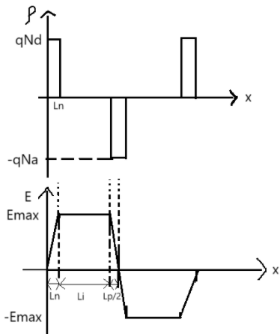
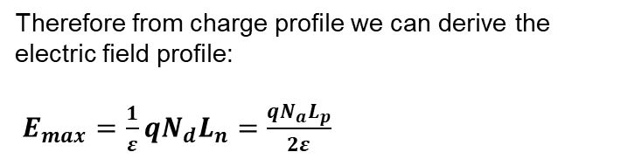
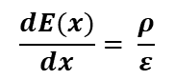
b. Electric Field Profile of Diode
Since, Electric field is given by:
$$\frac{dE(x)}{dx}= \frac{ρ}{ε}$$
Therefore from charge profile we can derive the electric field profile:
$E_{max}=\frac{1}{ε}qN_{d}L_{n}=\frac{qN_{a}L_{p}}{2ε}$

Slide 31
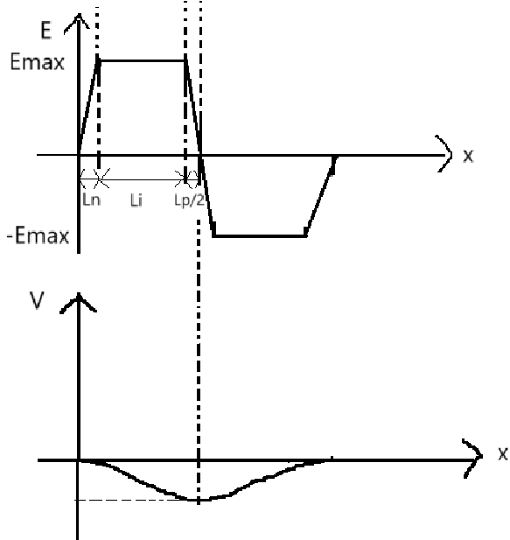
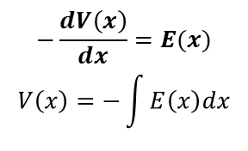
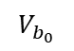
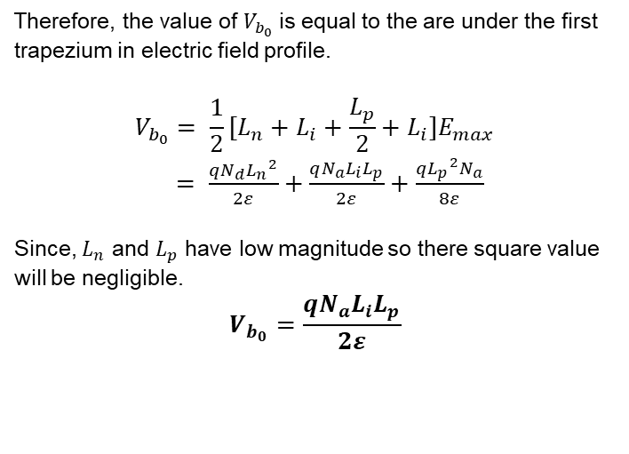
b. Potential Profile of Diode
Since, Potential is given by:
$$−\frac{dV\left(x\right)}{dx}=E(x)$$
$$V\left(x\right)=−\int{E\left(x\right)dx}$$
Therefore, the value of $V_{b_{0}}$ is equal to the are under the first trapezium in electric field profile.
$$V_{b_{0}}= \frac{1}{2}[L_{n}+L_{i}+{\frac{L_{p}}{2}+L}_{i}]E_{max}$$
$= \frac{qN_{d}{L_{n}}^{2}}{2ε}+\frac{qN_{a}L_{i}L_{p}}{2ε}+\frac{q{L_{p}}^{2}N_{a}}{8ε}$
Since, $L_{n}$ and $L_{p}$ have low magnitude so there square value will be negligible.
$$V_{b_{0}}=\frac{qN_{a}L_{i}L_{p}}{2ε}$$
$$V_{b_{0}}$$

